Slide 1
Application of meta-heuristics for localization, energy and path optimization in Sensor Network Programme: B. Tech in CSE
Mentor :Ms. Vaishali R Kulkarni
Group No. : Group 9
Team Leader : Rahul Kumar
Department : Computer Science

Slide 2
Project Team
Sl no. | Registration no. | Students
1. | 15ETCS002008 | Biswajit Basak
2. | 15ETCS002033 | Rahul Kumar
3. | 15ETCS002036 | Rohan Kumar
4. | 15ETCS002048 | Tushar Agarwal

Slide 3
Outline
Motivation/Need for study
Title and Aim
Objectives
Methods and Methodology
Expected Outcomes
Gantt Chart
Work load allocation
References

Slide 4
Need for Study
Wireless sensor networks (WSNs) are networks of autonomous sensor nodes (motes) and one or more base stations.
Possible applications of WSN are in monitoring and sensing eg: Traffic surveillance, health care, natural calamities, environmental monitoring etc .
Challenges in WSN are deployment, routing, localization and energy consumption.
There is a need to address these challenges and provide a robust, autonomous, flexible and inexpensive solution. Swarm Intelligence (SI) algorithms have such qualities.

Slide 5
Title
Application of meta-heuristics for localization, energy and path optimization in Sensor Network

Slide 6
Aim
To develop SI algorithms to address the challenges in localization, energy consumption and path optimization of sensors in WSN.

Slide 7
Objectives
To do literature survey in SI algorithms and challenges in WSN.
To apply SI algorithms to achieve accurate location estimation, energy optimization and deployment of sensors in WSN.
To implement and test the simulations.
To perform comparative analysis of traditional deterministic algorithms with bio-inspired SI algorithms.
To document the project report and publish in reputed journal or conferences.

Slide 8
Objectives
To do literature survey in SI algorithms and challenges in WSN.
-
To apply SI algorithms to achieve accurate location estimation, energy optimization and deployment of sensors in WSN.
-
To implement and test the simulations.
To perform comparative analysis of traditional deterministic algorithms with bio-inspired SI algorithms.
To document the project report and publish in reputed journal or conferences.

Slide 9
Methods and Methodology /Block Diagram
Literature survey
- Current technology being used
- Collecting information about the issues in WSN
Performance analysis
- Efficiency of SI Algorithm
- Energy Consumption of Wireless Sensors

Slide 10
Methods and Methodology contd..
Design
WSN scenario with static and mobile sensor nodes.
Localization in static and mobile WSN.
Implementation
- Simulator
- Localization issue of WSN will be solved using Ant Colony Optimization (ACO).
- Path Planning issue will be solved using Particle Swarm Optimization (PSO)
- Energy Consumption issue will be solved using Firefly Algorithm
Testing
- Test Scenarios with known data
- Test Scenarios with unknown data

Slide 11
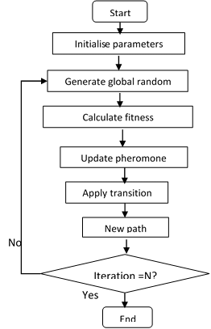
ACO Flowchart

Slide 12
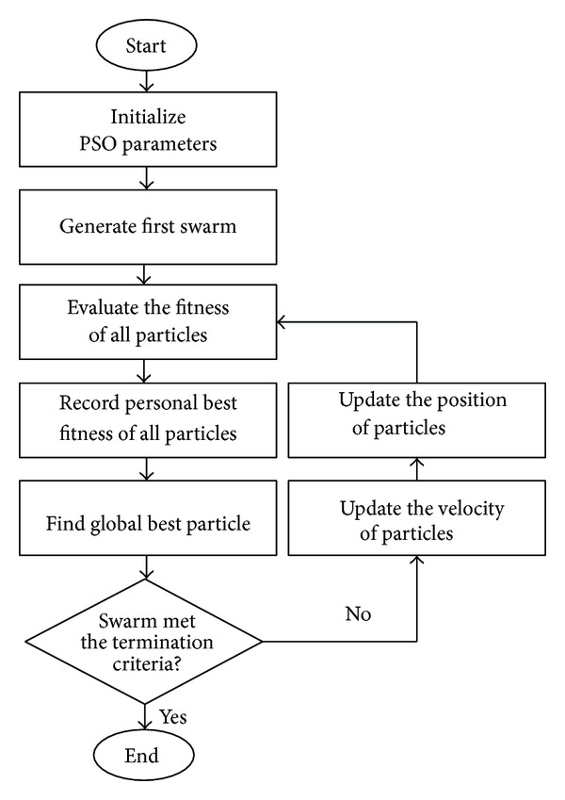
PSO Flowchart

Slide 13
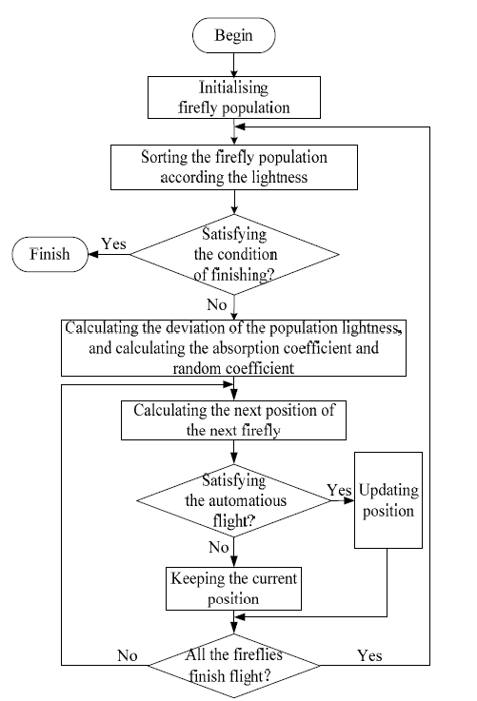
Firefly Flowchart

Slide 14
Expected Outcomes
Product Prototype/Tool
An optimized algorithm for WSN having higher efficiency than the current algorithm.

Slide 15
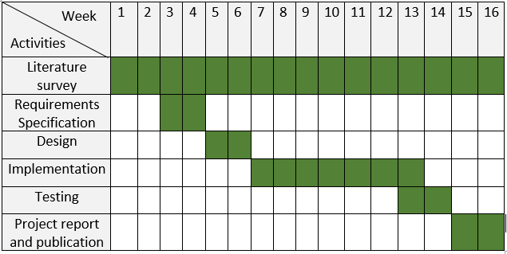
Gantt Chart

Slide 16
Work Load Allocation
Objectives | Biswajit Basak | Rahul Kumar | Rohan Kumar | Tushar Agarwal
Literature Survey
Requirement Analysis
Design
Implementation
Testing
Report Generation

Slide 17
References
Liu, C., Gao, F., & Jin, N. (2014). Design and Simulation of a Modified Firefly Algorithm. 2014 Seventh International Joint Conference on Computational Sciences and Optimization.
Ieeexplore.ieee.org. (2019). A new modified firefly algorithm for function optimization - IEEE Conference Publication. [online] Available at: https://ieeexplore.ieee.org/abstract/document/7755239 [Accessed 10 Feb. 2019].
Ieeexplore.ieee.org. (2019). A hybrid firefly algorithm - IEEE Conference Publication. [online] Available at: https://ieeexplore.ieee.org/document/8054023 [Accessed 10 Feb. 2019].

Slide 18
Thank You

